Slide 1
Welcome To Our Presentation!
Project Name: Jackpot Game
Supervised by
Bismoy Jahan
Course: Digital Logic and Circuits Lab Section: S Semester: Spring 2024-25 Group: 04

Slide 2
Group Members:
Name | Student ID
Satadru Barua Jeet | 23-52224-2
Wakar Alvee | 23-51784-2
Mehedi Hasan Soaib | 23-51621-2
MD. Rafayet Hossain Zanith | 23-52178-2
S.M Tagrib Uddin | 23-51332-1

Slide 3
Abstract
Enables to test luck on 12.5%-win percentage basis.
Various components are used.
If the predetermined bit and the Synchronized-Up Counter bit matches, the Jackpot is declared.
Otherwise, It's not a Jackpot, Red LED stays on.

Slide 4
Apparatus
JK Flip-Flops: 3 pcs [IC 7476]
555 Timer: 1 pc [IC LM555CN]
3-bit Comparator: 1 pc [IC 7485]
DIP Switch: 1 pc
Other Components like AND Gate, OR Gate, Resistors and Capacitors with different values, Indicator lights, Voltage sources, Switch etc. were also used.

Slide 5
Theory
The Jackpot Game is a digital logic project that simulates a simple game using basic electronic components. A 555 timer is used in astable mode to generate continuous clock pulses. These pulses are fed into a 3-bit synchronous JK flip-flop counter, which produces a binary output that changes with each pulse. A set of three DIP switches allows the user to manually input a 3-bit binary number. The output of the counter is compared with the user’s input using a 3-bit digital comparator. If the two 3-bit values match, the comparator activates a green LED to indicate a win. If the values do not match, a red LED lights up to indicate a loss. This setup creates a simple yet interactive digital game that demonstrates the practical use of timers, flip-flops, comparators, and basic logic principles.

Slide 6
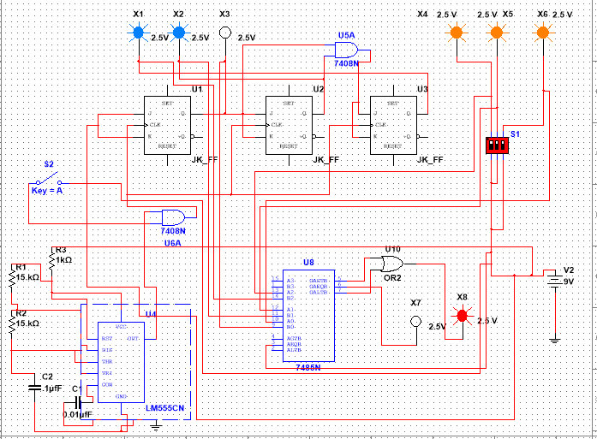
Circuit Diagram

Slide 7
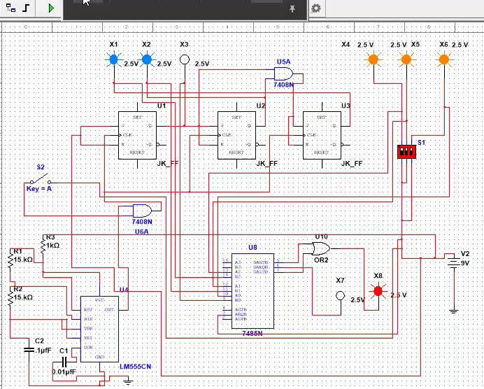
Demonstration

Slide 8
For the previous video, in the MultiSim simulation, we begin by setting the DIP switch input to “111”. Once the counter is started, it begins cycling through binary values. At any given moment, if we pause the simulation, we can observe the current output of the counter. In this instance, the counter output is also “111”. Both the DIP switch value and the counter output are fed into a comparator, which checks for equality. Since the two values match, the comparator signals a match by turning on the green indicator light, confirming correct operation.

Slide 9
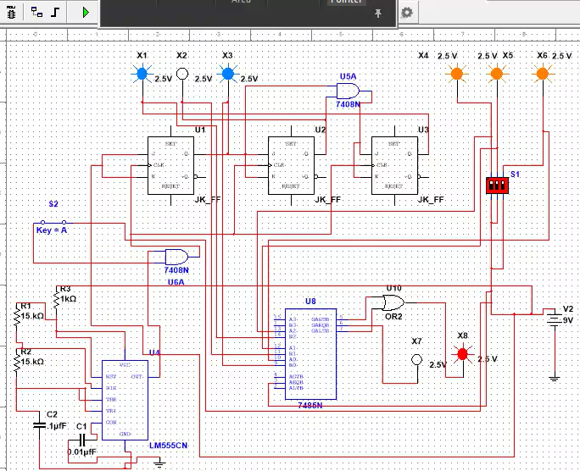

Slide 10
In this MultiSim simulation, we start by setting the DIP switch input to “111”. After starting the counter, it begins cycling through a sequence of binary values. At any point, we can pause the simulation to check the current counter output. For instance, during one run the counter output is “100”, and in another it is “010”. Both the DIP switch value and the counter output are sent to a comparator, which evaluates whether the two values are equal. Since they do not match, the comparator correctly identifies the mismatch and turns on the red indicator light, verifying that the circuit is functioning as expected.

Slide 11
Methodology and Results
For this project, we used three JK flip-flops to create a 3-bit synchronous counter. These flip-flops count from 0 to 7 in binary with every clock pulse. We made the clock pulses using a 555 timer. The 555 timer is set in astable mode, so it makes a continuous square wave signal that goes to the flip-flops’ clock pins. Next, we used a DIP switch to manually set a 3-bit number. This is the number we want the counter to match. To check if the counter and the DIP switch outputs are the same, we used a digital comparator chip. If they match, the comparator output goes high, and a green LED turns on. This means we got the jackpot. If they don’t match, a red LED turns on to show that we didn’t get the jackpot. We connected LEDs and resistors to see these results. After building the circuit, we ran the simulation in Multisim to test if everything worked right. This project helped us understand how to use flip-flops, comparators, and 555 timers together in a digital logic circuit.

Slide 12
Limitations
1. Limited Bit Range.
2. No Debouncing Mechanism
3. No Reset or Pause Feature
4. Fixed Clock Speed.
5. No Score Tracking
6. Power Supply Sensitivity

Slide 13
Conclusion
The Jackpot Game successfully demonstrates key digital logic concepts by combining clock generation, binary counting, and comparison in an interactive setup. It provides a simple yet effective way to understand the operation of flip-flops, counters, and comparators through hands-on learning.

Slide 14
THANK YOU!!

